Slide 1
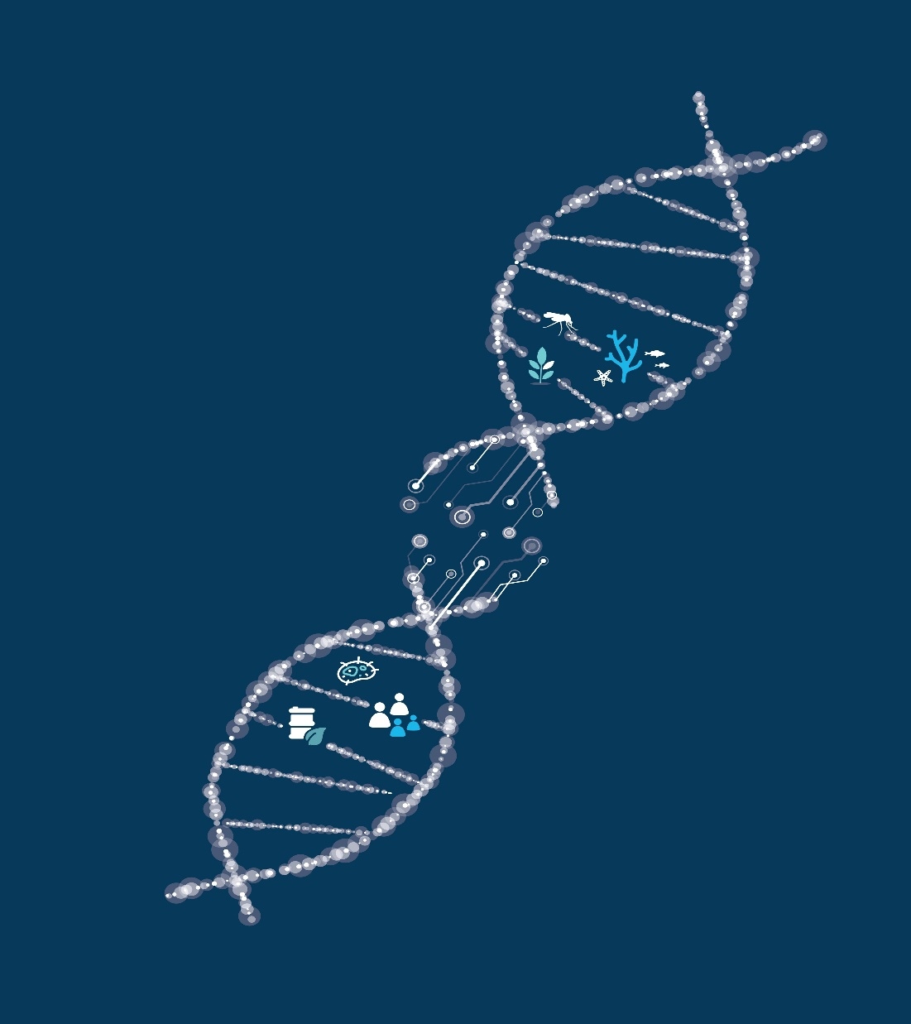
Optimized Experimental Design for Translation Initiation using Machine Learning
Mengyan Zhang, Maciej Holowko, Cheng Soon Ong
Data61, CSIRO; Australian National University
Notes:
For C3DIS 2020 (Collaborative conference on computational and data intensive science)

Slide 2
Contents
What‘s the objective?
Background
Our approach
Synthetic Biology
Gaussian Process Upper Confidence Bound
Results
Future work

Slide 3
Contents
What‘s the objective?
Background
Our approach
Synthetic Biology
Gaussian Process Upper Confidence Bound
Results
Future work

Slide 4
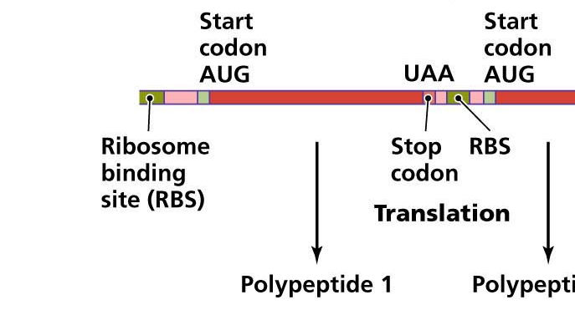
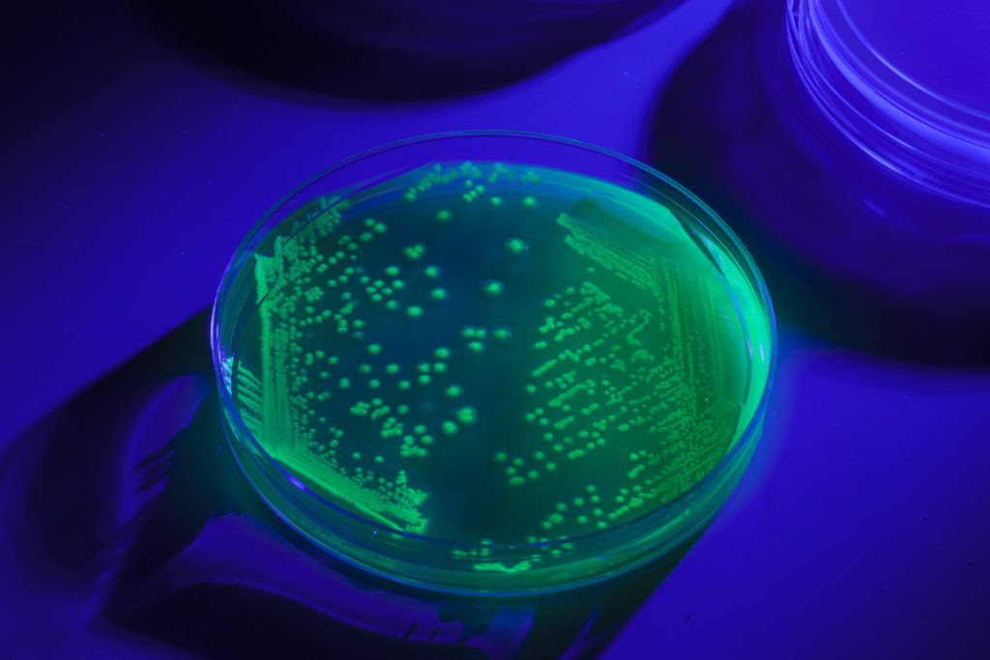
What’s the objective?
mRNA
affect translation initiation rate and
thus affect the protein expression level.
Green Fluorescent Protein (GFP)
Design Ribosome Binding Site (RBS) sequences in batch
Optimize the protein expression level.
1
Notes:
This figure show the process of translation. In synthetic biology, parts of DNA can be modified and influence the protein expression. We focus on the ribosome binding site, the RBS, which is a sequence of nucleotides upstream of the start codon of an mRNA. The RBS is responsible for recruitment of a ribosome during the initiation of protein translation
We aim to design the RBS sequences in batch, with the goal of optimizing the protein expression level.
We can estimate which by making the RBS to initiate translation of Green Fluorescent Protein, the GFP, and then measuring the fluorescence of bacterial culture.
#which will be proportional to the number of GFP molecules being present in the cell, which in turn is proportional to their production rate.
#Synthetic biology is an emerging life sciences discipline that merges genetic engineering with actual engineering approach.
#In synthetic biology， parts of DNA are divided into genetic parts, each with specific function and with defined characteristics.
Ribosome binding site, the RBS, is one example of such a part.
Its function is to start translation of the RNA, information carrier, into the protein, execution molecule.

Slide 5
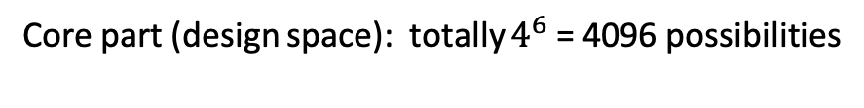
What’s the objective?
Design Ribosome Binding Site (RBS) sequences in batch
Optimize the protein expression level.
RBS sequence | Normalized* Protein Expression Level
TTAAGTAAGCGGGGAAAATA | 1.58
TTAAGTAAGCGGGGAAAATA | 1.42
AAAGATGAGGAGTGCAAAAA | 0.14
AAAGATGAGGAGTACAAAAA | 2.88
Score is a distribution
(noise)
Core part (design space): totally $4^{6}$ = 4096 possibilities
* zero mean and unit variance normalization
2
Notes:
This table shows some example in the baseline data.
Features are 20-nucleotide RBS sequences. For our design, the cental 6 positions are core part we want to design, which is shown in red. That is, we fix the rest of part as the same a consensus sequence. Therefore, the total possibilities would be 4^6.
The label is the normalised protein expression level. And note that for one sequence, label can be different. In other words, the label is generated from an unknown distribution.

Slide 6
What’s the objective?
Design Ribosome Binding Site (RBS) sequences in batch
Optimize the protein expression level.
To find the RBS with best possible protein expression level
by labelling as little data as we can!
2

Slide 7
Contents
What‘s the objective?
Background
Our approach
Synthetic Biology
Gaussian Process Upper Confidence Bound
Results
Future work

Slide 8
Background & Challenges
Expensive for labelling
No high quality data available
ML algorithms needed to save labor
Synthetic Biology needed to generate reliable data
3
Notes:
In synthetic biology, labelling is expensive and there is no high quality baseline data available for us to use.
So it’s interesting to combine ML and synbio together, on the one hand, ml helps to recommends sequences for labelling to save labor; one the other hand, synbio generates reliable labels.

Slide 9
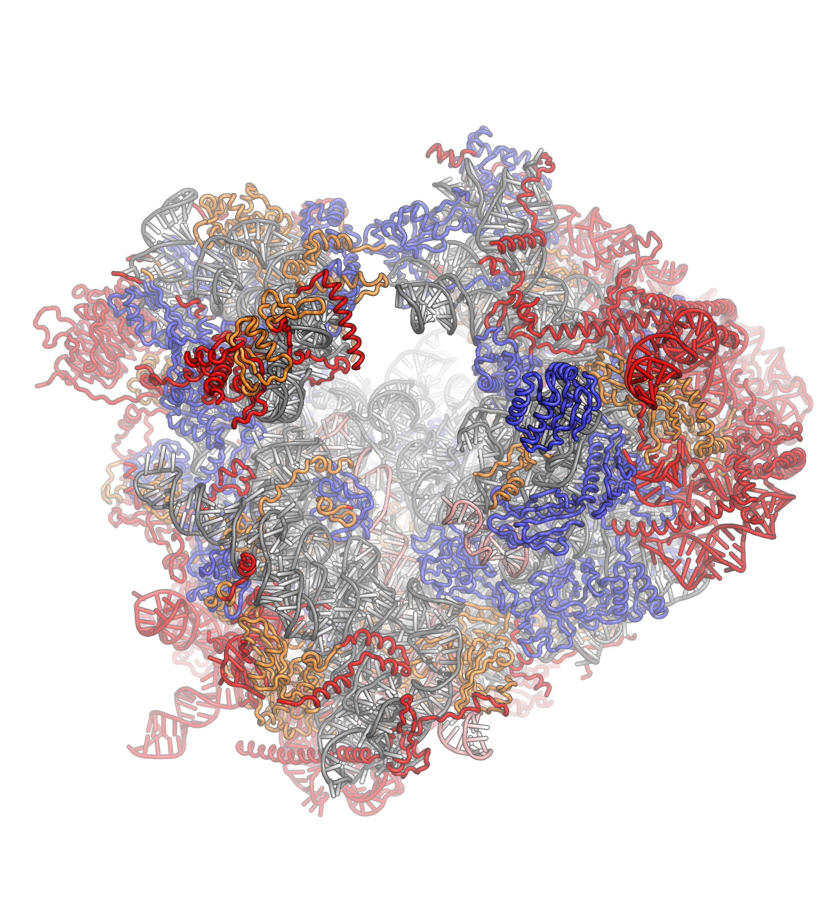
Modelling RBS
RBS calculators are based on thermodynamic data
Often incorrect
Currently available databases are of low quality
4
Notes:
The state of art model is thermodynamic based RBS calculator.
However, the measure are often incorrect, with high variability and they have to be confirmed experimentally in many cases.
At the same time, publicly available databases with initiation rates of RBSes are of low quality

Slide 10
Machine Learning Algorithm
Regression models used in Synthetic Biology [1][3]
Decision trees
Kernel methods (support vector machines, kernel ridge regression)
Gaussian process models: combining kernel methods and Bayesian learning
Deep-learning methods: requires large amount of data
5

Slide 11
Contents
What‘s the objective?
Background
Our approach
Synthetic Biology
Gaussian Process Upper Confidence Bound
Results
Future work

Slide 12
CSIRO-UQ BioFoundry
Combination of hardware and software solutions
Allows production of genetic variants on unprecedented scale
Delivery of high volume highly-controlled RBS variant data
Notes:
Synthetic biology is currently entering a new phase of automated design and build paradigm.
Instead of scientists having to build genetic variants manually, the work is handled by automated systems which increases throughput and reproducibility. Instead of single digit variants, hundreds can be generated daily.
We have collaborated on this project with the CSIRO-UQ BioFoundry – an automated synthetic biology facility based in Brisbane. Scientists there were able to generate the required RBS variants and test them for us .

Slide 13
Gaussian Process Upper Confidence Bound [2]
What we need from machine learning?
1. A (Bayesian) regression algorithm which predicts both
Mean
Uncertainty
2. A online/batch algorithm which recommends sequences to design
Gaussian Process Regression
Bandits Algorithms:
Upper Confidence Bound
7

Slide 14
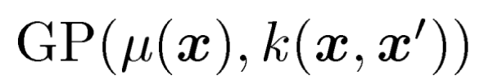
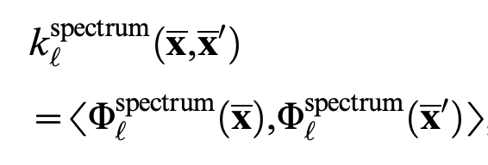
Gaussian Process Upper Confidence Bound
e.g. AGAAGA
Spectrum Kernel
Sum of spectrum kernels
AGA | GAA | AAG | AAA | …
2 | 1 | 1 | 0 | 0
TTAAGTA AGCGGG GAAAATA
8
Notes:
A GP is specified by its mean function and covariance function. For our case, each x is corresponding to a RBS sequence.
For the choice of kernel, we choose to use spectrum kernel, which takes two sequences as input. Phi x is a mapping of the sequence x into it’s substring feature space. Each dimension is the count of the number of occurrences of s in x.
Futhermore, considering in the baseline data and our design sequences, there is clear pattern that the core part changes a lot and the other part almost remain. So instead of calculating spectrum kernel to the whole sequence, we calculate the spectrum for each of the three parts and sum them together.

Slide 15
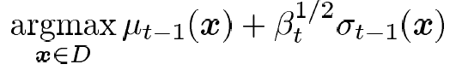
Gaussian Process Upper Confidence Bound
Balance the exploitation and exploration
Round 5
Round 6
9
Notes:
GP gives us posterior mean and std, then the upper confidence bound algorithm computes the upper confidence bound of the predictions by adding up the mean and std, where beta is hyperparameter balance the mean and std. For each round, we basically pick the sequence gives the maximum upper confidence bound.
The two plots here shows the 5th and 6th round of ucb runs, where the x axis is the different choices we have, the y axis is the corresponding labels. The red points are the observations and the blue line shows the predictions. The shade here is the uncertainty. At the round 5, we pick the point which gives the maximum upper confidence bound, observe its label and then predicts the new mean and std, based on which we select the new recommendations on round 6.
The UCB algorithm actually balance the exploration and exploitation in terms of decision making with uncertainty. One the one hand, we would like explore the regions we have no or very little knowledge about, to figure out whether there is sequence inside those regions which give us good labels. On the other hand, we want to select the regions where we have observed high label, to optimize our choices. The UCB algorithms balance it by carefully choosing beta.

Slide 16
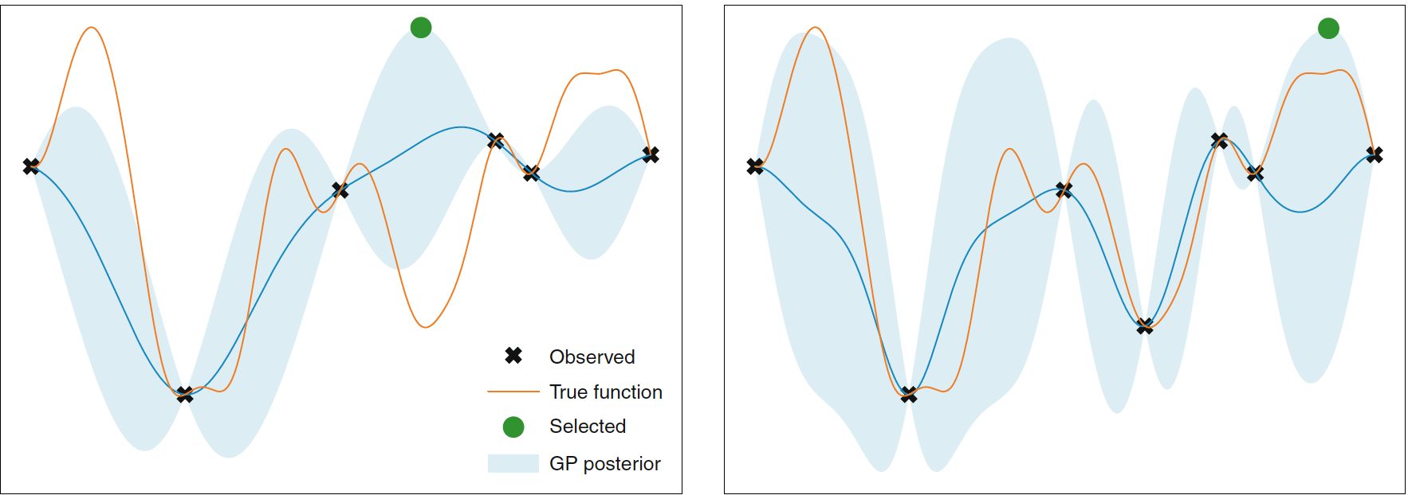
Gaussian Process Upper Confidence Bound
[2][3]
9
Notes:
GP gives us posterior mean and std, then the upper confidence bound algorithm computes the upper confidence bound of the predictions by adding up the mean and std, where beta is hyperparameter balance the mean and std. For each round, we basically pick the sequence gives the maximum upper confidence bound.

Slide 17
Contents
What‘s the objective?
Background
Our approach
Synthetic Biology
Gaussian Process Upper Confidence Bound
Results
Future work
单击此处The添加文本

Slide 18
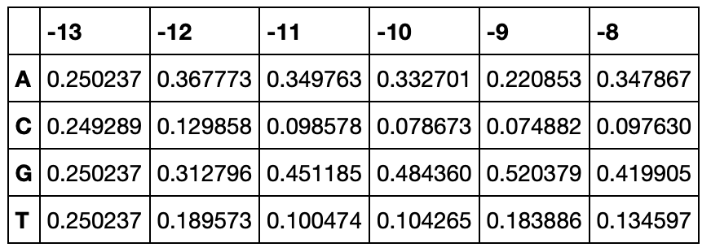
Experiment Setting
We design the first round 180 sequences for three groups:
SBP Change (60): single base pair change (evolution)
Random (60): uniformly random (30);
probability-based random (30)
3. Machine learning (60): GPUCB with sum of spectrum kernel
Based on TTTAAGAAGGAGATATACAT
A, C, G
10
Notes:
We design the first round sequences in three groups, where the first two groups as experimental control.
For the SBP group, we decide to change for each position rather than the central 6 positions, to get a better understanding how other positions influences the GFP level.
For the rest of two groups, we limit our design to the central positions, to focus the part is known to have most influence to the GFP performance.
For the ML design, we based on around 200 RBS data provided by Jarvis.

Slide 19
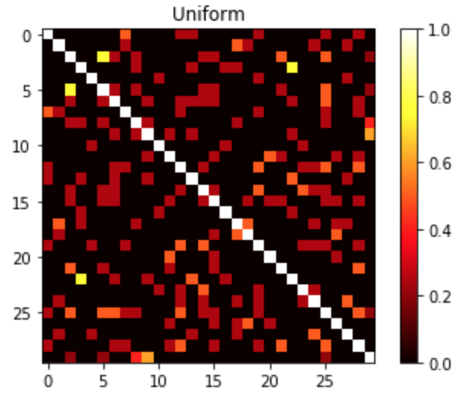
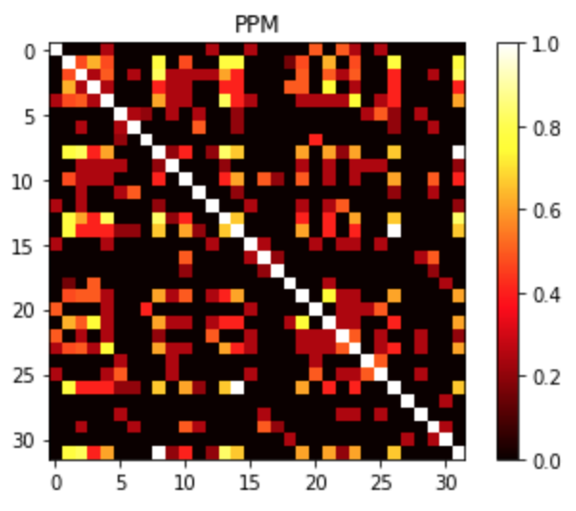
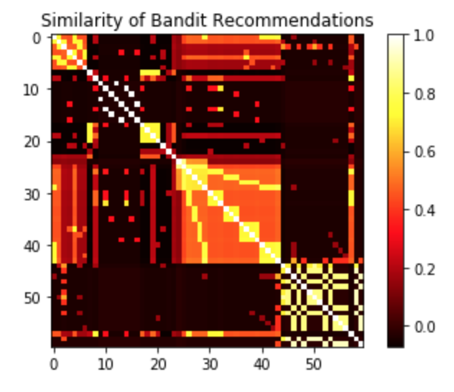
Sequence similarity
Uniform Random
Probability-based random
Bandit recommendations
11
Notes:
We show the similarities of sequences insides of second group and third group respectively via the heatmap, where x and y axis represents the sequences. Higher values represents higher similarity.
For uniform random, the matrix looks no pattern.
For probability-based random, the similarity increases compared with uniform random.
Intuitively, we hope the bandit recommendations can have several clusters in terms of similarity. In biology, similar sequences tends to have similar performance, thus in clusters, we expect sequences are similar to each other. On the other hand, very different sequences could have high scores respectively. that is, between clusters, the sequences will have small similarities.
This intuition accords with the our bandit recommendations, we can a few clusters. Inside of clusters, they are very similar to each other. But the similarities between clusters are usually low.

Slide 20
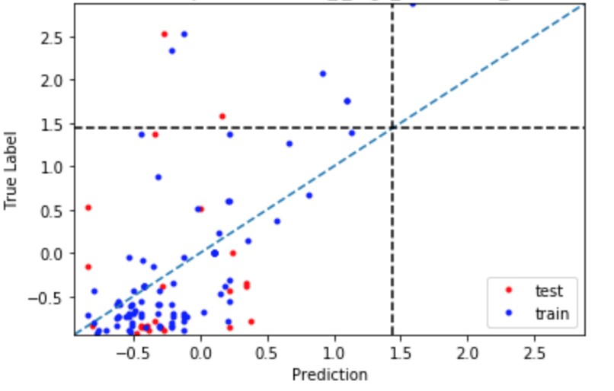
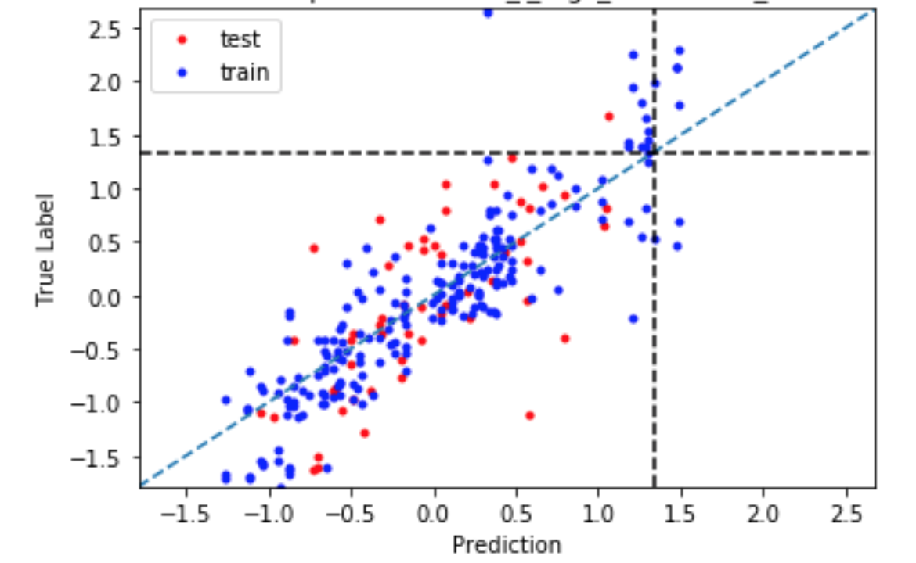
Results – GP predictions accurate
Baseline data
Partial* of first round result
* Only SBP and uniform random results are available for now
12
Notes:
For part of the first round result we get, we show the regression performance.
The x-axis is the prediction, and the y-axis is the true label. The left plot is for training and testing on baseline data. And the right one is for part of the first round result. We can see GP regression works better for the latter one, where the points are central to the diagonal.

Slide 21
Contents
What‘s the objective?
Background
Our approach
Synthetic Biology
Gaussian Process Upper Confidence Bound
Results
Future work

Slide 22
Future Work
Design RBS sequences for next few batches
Embedding sequences: NLP approaches?
Batch recommendations
Design promoters
Notes:
The project is still at the beginning stage and plan to design RBS sequences for several batches based on our approach.
….

Slide 23
Summary
Design Ribosome Binding Site (RBS) sequences in batch
Optimize the protein expression level.
SBP Change: single base pair change (evolution)
Random: uniformly random; probability-based random
Machine learning: GPUCB with sum of spectrum kernel

Slide 24
Optimized Experimental Design for Translation Initiation using Machine Learning
References
[1] Adrian J. Jervis et al. Machine Learning of Designed Translational Control Allows Predictive Pathway Optimization in Escherichia coli, 2019
[2] Niranjan Srinivas et al. Gaussian Process Optimization in the Bandit Setting: No Regret and Experimental Design, 2010
[3] Kevin K. Yang et al, Machine-learning-guided directed evolution for protein engineering, 2019
Thanks!
Mengyan.Zhang@anu.edu.au

